Slide 1
Information and media literacy

Slide 2
CONTENT
INTRODUCTION
INFORMATION LITERACY DEFINITION
INFORMATION LANDSCAPE
WHAT INFORMATION LITERACY INCLUDES?
WHAT IS MEDIA LITERACY ?
REFERENCES

Slide 3
Introduction
This guide gives a summary of how to prepare the academic community to be competent in Information and Media Literacy. It also helps you to understand that having information literacy skills are the fundamentals to thrive in a digital space.

Slide 4
What is information literacy ?
According to the American Library Association, "Information literacy is a set of abilities requiring individuals to 'recognize when information is needed and have the ability to locate, evaluate, and use effectively the needed information."

Slide 5
WHAT INFORMATION LITERACY INCLUDES?

Slide 6
WHAT INFORMATION LITERACY INCLUDES?
What is ‘College-level’ Research?
How should I search for resources?
How Do I Find the best sources ?
Can I trust the information I have found online?
I have found my sources now what ?
How and why should I give credit in my assignment?
What kinds of help do the library offer?
How do I contact a librarian now?
BACK TO CONTENT

Slide 7
What is College Level Research?
"College level research requires the kind of credible articles, books, eBooks, and media that you can find through the library.”
The longer you are in college, the more your instructors will be requiring you to use college level sources like scholarly & peer reviewed articles and even scholarly articles that have literature reviews, methodology and results.
NEXT
BACK

Slide 8
What is College Level Research?
Once you have your assignment, these are generally the stages of research:
1. You pick or are assigned a topic
2. You research your topic with an open mind, using college level books, eBooks, articles or media as determined by the assignment.
3. You draw conclusions about the topic based on what you discovered from the college level sources and write about your findings.
BACK

Slide 9
How should I search for resources?
Be
Your research will be far better if you:
Seek out and review
Seek out and review a variety of sources
Search
Search for sources in library catalogs, databases, and the web
Conduct
Conduct several searches using a variety of terminology related to your topic
Ask
Ask a librarian, "What might I be missing?" once you have searched for a variety of resources.
BACK
NEXT

Slide 10
How should I search for resources?
Watch this video about effective searching strategies. Click link below
https://www.youtube.com/watch?v=oP5EJQVNRmI&t=5s
BACK

Slide 11
How can you evaluate sources?
What is a 'quality' source?
Why should you be concerned about source quality as you research your topic? In fact, there are several reasons:
Faculty will consider the choices you made as they evaluate your work
A key skill of the digital age is evaluating information on the basis of credibility
Biased, incorrect, or misleading information will quickly diminish the credibility of your writing
As a participant in scholarly conversations, you have a responsibility to share only that information that contributes to the continuity of truth and discovery
BACK

Slide 12
How will you measure 'quality'?
First consideration:
What is your purpose?
Even within the sphere of academic writing, the manner in which you make use of sources can vary. Sources can provide:
Definitions and background to inform the reader
Illustrative examples for clarification of your assertions
Real-life examples or case studies to enliven your writing
Expert quotes, opinions or the findings of scholarly research
Data and statistics to support your assertions or conclusions
For the first three of the above, news sources, such as magazine and newspaper articles, and general books could provide excellent background and detail for more compelling writing.
BACK

Slide 13
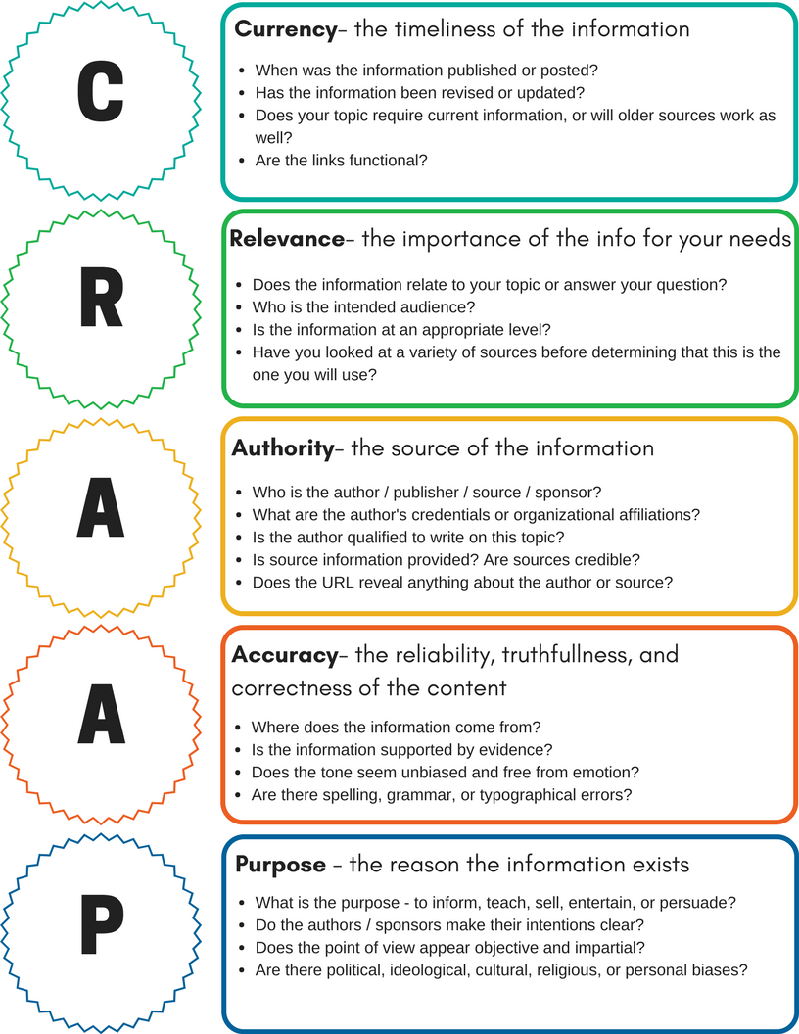
How Do I Find the best sources ?
Use the CRAAP test to determine whether you have located a credible and reliable source.
If it doesn't pass the CRAAP test, do not use it as a source for your college-level assignment.
BACK

Slide 14
Can I trust the information I have found online?
Watch this video on credible sources. Click link below
https://www.youtube.com/watch?v=AFEwwG7rq0E
BACK

Slide 15
I have found my sources now what ?
If you need assistance with your writing visit : Purdue OWL online writing lab.
START CRAFTING YOUR PAPER
CREATE AN OUTLINE FOR YOUR PAPER
INCORPORATE REFERENCES
BACK

Slide 16
How and why should I give credit in my assignment?
We cite to give proper credit to the source and to allow readers a path to the source.
There are many citation styles, but the we only use APA (American Psychological Association) style.
For assistance you can use the following site:
Purdue OWL https://owl.purdue.edu/owl/research_and_citation/apa_style/apa_formatting_and_style_guide/general_format.html
BACK

Slide 17
What kinds of help do the library offer?
The library offer the following services ?
Research guide assistance
Reference Services – Live Chat, email
One on one online sessions with students
Navigation assistance of database/s
Print resources
Scan documents
BACK

Slide 18
What kinds of help do the library offer?
BOOK A LIBRARIAN!
Give at least TWO DAYS of notice, you can meet with a librarian, one on one by making an appointment on http://gcflibrary.ddnsgeek.com/ under the tab Reserve-IT .
Here are the particulars:
Booking limitations:
1 appointment per week per patron.
Students only - no community users permitted.
Patrons can book up to 4 weeks in advance.
BACK

Slide 19
How do I contact a librarian now?
Visit the Library page @ http://gcflibrary.ddnsgeek.com/. Use the Ask a librarian tab to connect and chat to a librarian live or email us at librarysupport@gcfc.edu.jm.
BACK

Slide 20
NEXT

Slide 21
What is media literacy ?
According to the Center for Media Literacy, “Media Literacy is a 21st century approach to education.
It provides a framework to access, analyze, evaluate, create, and participate with messages in a variety of forms - from print to video to the Internet.
Media literacy builds an understanding of the role of media in society as well as essential skills of inquiry and self-expression necessary for citizens of a democracy.”
NEXT

Slide 22
NEXT

Slide 23
MEDIA LITERACY
Watch this video on Media Literacy. Click link below
https://www.youtube.com/watch?v=dt2CaHXuyWU

Slide 24
References
American Library Association.(2021). “Information Literacy”. Retrieved from https://literacy.ala.org/information-literacy/
CMAC. (2020). “What is Media Literacy?”. Retrieved from https://www.youtube.com/watch?v=dt2CaHXuyWU
Coonan, E., & Jane, S. (2014, April 29). "My dolly’s bigger than your dolly”, or, Why our labels no longer matter. Retrieved April 29, 2016, from https://librariangoddess.wordpress.com/2014/04/29/my-dollys-bigger/
NEXT

Slide 25
References
Madison College Libraries. (2020). “Information Literacy: Guide for Students: What is Information Literacy?”. Retrieved from https://libguides.madisoncollege.edu/InfoLitStudents
Madison College Libraries. (2020). “Howler Tutorials”. Retrieved from https://libguides.madisoncollege.edu/HOWLER
REMC Association of Michigan.(2021). “What is Media Literacy”. Retrieved from https://www.remc.org/classroom-resources/media-literacy/what-is-media-literacy/

