Slide 1
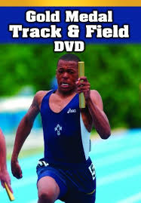
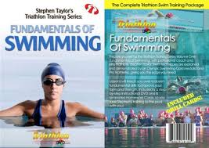
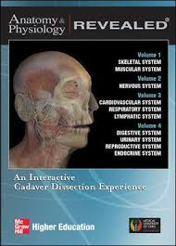
Did you know the G.C Foster library has a CD/DVD collection ?
Click Image
We have CD/DVD in subject areas:
Anatomy & physiology
Business Communication
Weight Conditions
Coach to Teach
Swimming
Spanish
First Aid and more
Next time you visit the library ask for CD/DVDS

Slide 2
Did you know the G.C Foster library has a CD/DVD collection ?
Taylor, Stephen (2007) Fundamental of swimming . Triathlon.
Click Image
We have CD/DVD in subject areas:
Anatomy & physiology
Business Communication
Weight Conditions
Coach to Teach
Swimming
Spanish
First Aid and more
Next time you visit the library ask for CD/DVDS

Slide 3
Did you know the G.C Foster library has a CD/DVD collection ?
Gold medal Track and Field. (2005).Champaign Il. Human Kinetics
Click Image
We have CD/DVD in subject areas:
Anatomy & physiology
Business Communication
Weight Conditions
Coach to Teach
Swimming
Spanish
First Aid and more
Next time you visit the library ask for CD/DVDS

Slide 4
Did you know the G.C Foster library has a CD/DVD collection ?
We have CD/DVD in subject areas:
Anatomy & physiology
Business Communication
Weight Conditions
Coach to Teach
Swimming
Spanish
First Aid and more
Click Image
Next time you visit the library ask for CD/DVDS

Slide 5
Did you know the G.C Foster library has a CD/DVD collection ?
We have CD/DVD in subject areas:
Anatomy & physiology
Business Communication
Weight Conditions
Coach to Teach
Swimming
Spanish
First Aid and more
Click Image
Next time you visit the library ask for CD/DVDS

Slide 6
Did you know the G.C Foster library has a CD/DVD collection ?
We have CD/DVD in subject areas:
Anatomy & physiology
Business Communication
Weight Conditions
Coach to Teach
Swimming
Spanish
First Aid and more
Next time you visit the library ask for CD/DVDS

